Slide 1

Amy (Vincent) Baker
OFFLU Swine Influenza Virus technical meeting
16 June 2022
USDA-ARS National Animal Disease Center Update

Slide 2


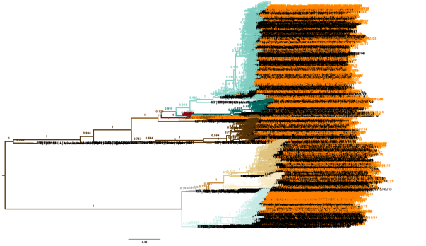
Tools to monitor diversity of
IAV in Swine
Influenza Research Database (https://www.fludb.org )
Bacterial and Viral Bioinformatics Resource Center (https://www.bv-brc.org)
octoFLU and octoFLUshow
(https://flu-crew.org/ )
Iowa State University FLUture (https://influenza.cvm.iastate.edu)
Nextstrain for swine IAV
(https://flu-crew.org/ )
Tavis Anderson

Slide 3

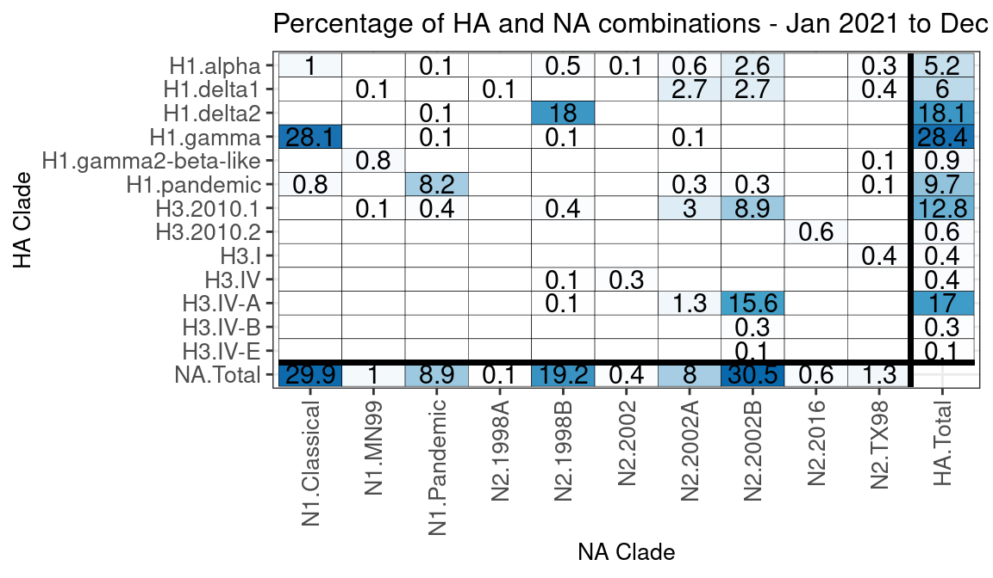
HA/NA pair frequency from USDA surveillance
Total HA & NA combinations – 778
Number excludes missing data and mixed strains for NA and HA genes

Slide 4
NADC Research Activities
OFFLU swine report to WHO VCM
RP HA/NA vaccine studies
Swine to ferret transmission of dominant US swine strains
Updated antigenic characterization of US swine H1 and 2010.1 H3N2
Implementation of Nextstrain to identify resurgence of 1990.4a H3N2
Pathogenesis and transmission of 2.3.4.4b H5N1 US reassortants in swine

Slide 5
2021-22 Publications
Powell JD, Abente EJ, Chang J, Souza CK, Rajao DS, Anderson TK, Zeller MA, Lewis NS, Vincent AL. Characterization of contemporary 2010.1 H3N2 swine influenza A viruses circulating in United States pigs. Virol. 2021;553:94-101. doi: 10.1016/j.virol.2020.11.006.
Kaplan BS, Falkenberg S, Dassanayake R, Neill J, Velayudhan B, Li F, Vincent AL. Virus strain influenced the interspecies transmission of influenza D virus between calves and pigs. Transbound Emerg Dis. 2021 Nov;68(6):3396-3404. doi: 10.1111/tbed.13943. Epub 2021 Jan 7. PMID: 33259672.
Kaplan BS, Anderson TK, Chang J, Santos J, Perez D, Lewis N, Vincent AL. Evolution and Antigenic Advancement of N2 Neuraminidase of Swine Influenza A Viruses Circulating in the United States following Two Separate Introductions from Human Seasonal Viruses. J Virol. 2021 Sep 27;95(20):e0063221. doi: 10.1128/JVI.00632-21. Epub 2021 Aug 11. PMID: 34379513; PMCID: PMC8475526.
Zeller MA, Chang J, Vincent AL, Gauger PC, Anderson TK. Spatial and temporal coevolution of N2 neuraminidase and H1 and H3 hemagglutinin genes of influenza A virus in US swine. Virus Evol. 2021 Oct 8;7(2):veab090. doi: 10.1093/ve/veab090. PMID: 35223081; PMCID: PMC8864744.
Souza CK, Anderson TK, Chang J, Venkatesh D, Lewis NS, Pekosz A, Shaw-Saliba K, Rothman RE, Chen KF, Vincent AL. Antigenic Distance between North American Swine and Human Seasonal H3N2 Influenza A Viruses as an Indication of Zoonotic Risk to Humans. J Virol. 2022 Jan 26;96(2):e0137421. doi: 10.1128/JVI.01374-21. Epub 2021 Nov 10. PMID: 34757846; PMCID: PMC8791259.
Arendsee ZW, Chang J, Hufnagel DE, Markin A, Janas-Martindale A, Vincent AL, Anderson TK. octoFLUshow: an Interactive Tool Describing Spatial and Temporal Trends in the Genetic Diversity of Influenza A Virus in U.S. Swine. Microbiol Resour Announc. 2021 Dec 16;10(50):e0108121. doi: 10.1128/MRA.01081-21. Epub 2021 Dec 16. PMID: 34913720; PMCID: PMC8675265.
Sharma A, Zeller MA, Souza CK, Anderson TK, Vincent AL, Harmon K, Li G, Zhang J, Gauger PC. Characterization of a 2016-2017 Human Seasonal H3 Influenza A Virus Spillover Now Endemic to U.S. Swine. mSphere. 2022 Feb 23;7(1):e0080921. doi: 10.1128/msphere.00809-21. Epub 2022 Jan 12. PMID: 35019669; PMCID: PMC8754165.
Kimble JB, Wymore Brand M, Kaplan BS, Gauger P, Coyle EM, Chilcote K, Khurana S, Vincent AL. Vaccine-Associated Enhanced Respiratory Disease following Influenza Virus Infection in Ferrets Recapitulates the Model in Pigs. J Virol. 2022 Mar 9;96(5):e0172521. doi: 10.1128/JVI.01725-21. Epub 2022 Jan 5. PMID: 34985999; PMCID: PMC8906406.

Slide 6
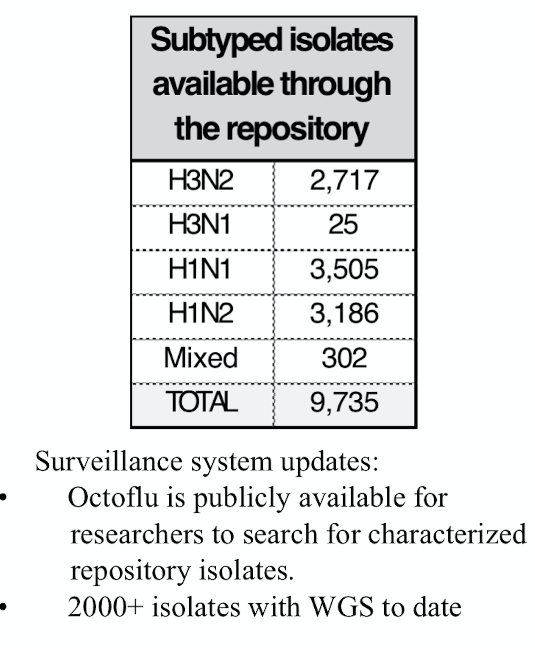
USDA – NVSL Update

