Slide 1

Rejane Schaefer
Researcher, Embrapa Swine and Poultry
Concórdia, SC, Brazil.
BRAZIL
OFFLU Swine Influenza Virus technical meeting
16 June 2022
Evolution of Influenza A Virus in Swine in Brazil

Slide 2
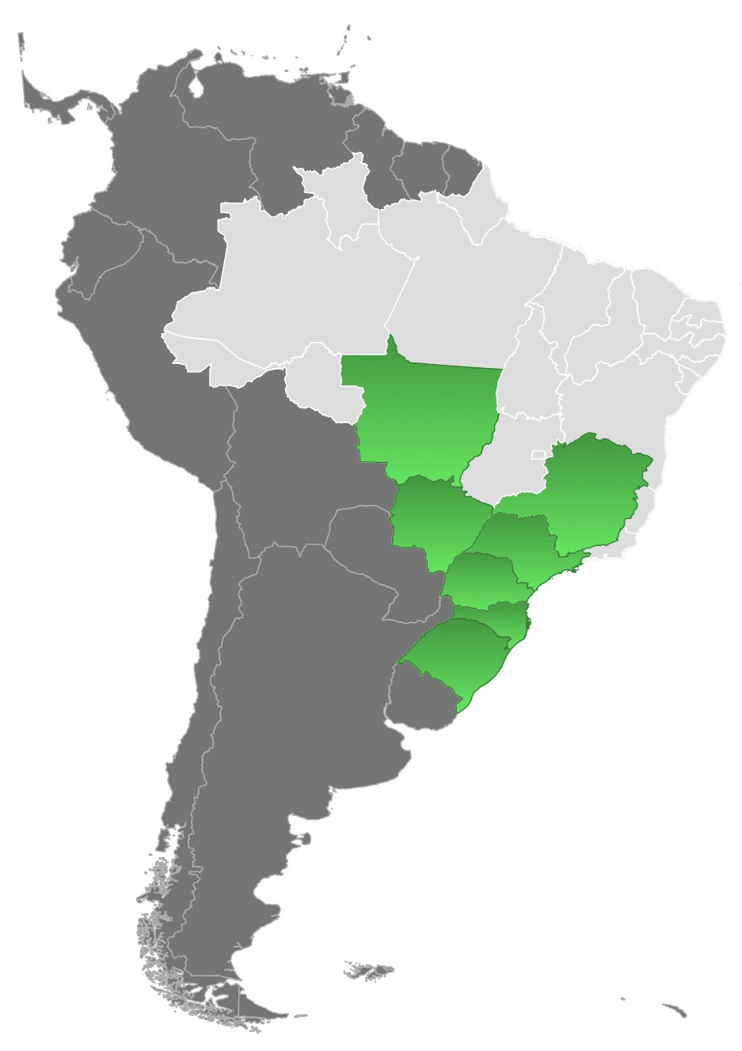

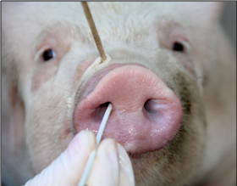
A brief update
Swine IAV passive surveillance
swIAV isolates from pig herds located in 7 Brazilian states
(RS, SC, PR, MS, MT, SP, MG).
H1N1, H1N2 and H3N2
(2010-2020)
96.2% of pork production in Brazil

Slide 3

HA-H1pdm (1A.3.3.2)
Clade | Subtype (n. of isolates) | Collection date | Brazilian State¹ | tMRCA² | 95% HPD
1 | H1N1 (5) | 2017-2019 | SC, MG | 2008.72 | 2007.08 | 2010.74
2 | H1N1 (3) | 2012-2018 | RS, SC | 2008.07 | 2007.25 | 2008.93
3 | H1N1 (3) | 2010-2015 | SC | 2009.82 | 2009.67 | 2011.01
4 | H1N1 (26), H1N2 (10) | 2014-2020 | RS, SC, PR, MG | 2011.69 | 2009.89 | 2011.87
5 | H1N1 (3) | 2011-2014 | RS | 2010.28 | 2009.71 | 2010.84
6 | H1N1 (2) | 2018 | PR | 2016.79 | 2016.22 | 2017.4
7 | H1N1 (2) | 2017 | RS, MG | 2016.74 | 2016.48 | 2016.96
8 | H1N1 (2) | 2019 | SC | 2018.84 | 2018.6 | 2019
¹RS, Rio Grande do Sul; SC, Santa Catarina; PR, Paraná (South Region); MG, Minas Gerais; SP, São Paulo (Southeast); MS, Mato Grosso do Sul (Midwest).
²Time of the Most Recent Common Ancestor.
Junqueira et al., 2022 (Unpublished)

Slide 4
HA-H1 1B.2
Genetic lineages | Subtype (n. of isolates) | Collection date | Brazilian State¹ | Estimated time of human-to-swine introduction
1B.2.3 | H1N2 (12), H1N1 (5), H1Nx (1) | 2011-2020 | RS, SC, PR, MS, MG | 2003-2008
1B.2.4 | H1N2 (31), H1N1 (1) | 2011-2020 | RS, SC, PR, SP | 2001-2002
1B.2.6 | H1N2 (5), H1N1 (1) | 2019 | MG | 1985-2009
¹RS, Rio Grande do Sul; SC, Santa Catarina; PR, Paraná (South Region); MG, Minas Gerais; SP, São Paulo (Southeast); MS, Mato Grosso do Sul (Midwest).
Tochetto et al., 2022 (Unpublished)

Slide 5

Final Remarks and Ongoing Projects
H1N1pdm, human-seasonal origin H1N1 and H1N2 swIAVs are widespread in pig herds in Brazil, where they continue to evolve;
These particular H1N2 and H1N1 swIAV clades 1B.2 appear to be specific to Brazil;
Analysis of the H3, N1 and N2 gene sequences are in progress;
New sequencing (virus isolates from 2021-2022);
Continue to monitor influenza in pigs;
Scientific divulgation (IPVS 2022, publications).

Slide 6
Thank you
rejane.schaefer@embrapa.br

